Slide 1
How to create a custom Space for Spatial

Slide 2
Table of Contents
Basics
-What is a Space? Slide 3
-What is Unity? Slide 4
Creating a New Space
-Method 1: Using the Starting Template Slide 5
-Method 2: Manual Configuration Slide 17

Slide 3
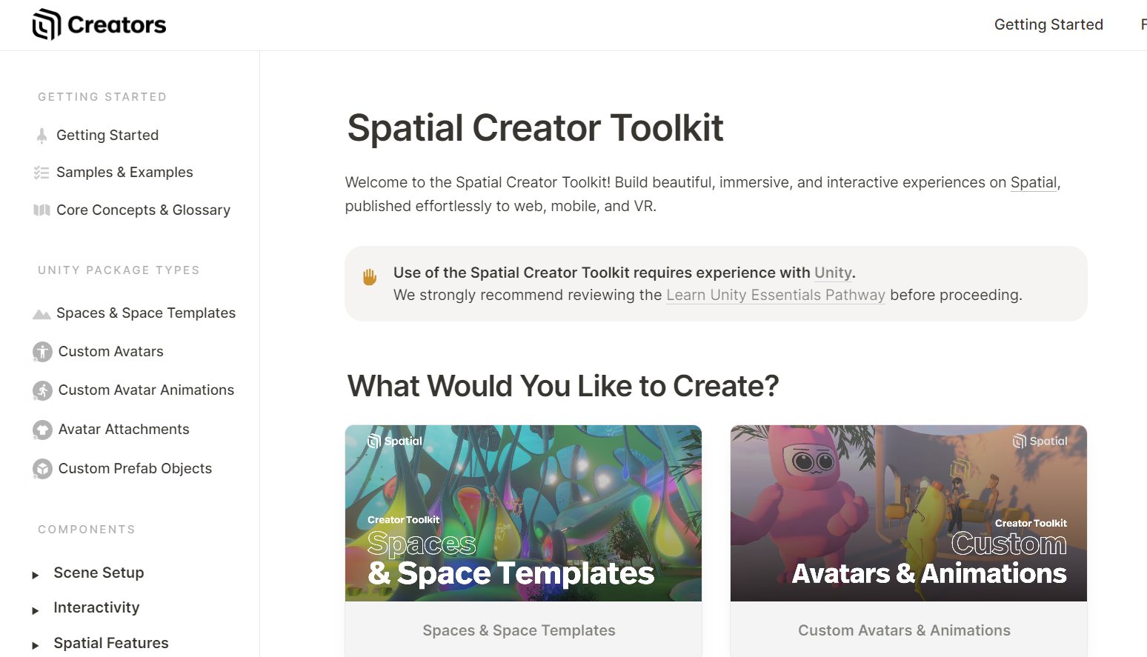
Basics What is a Space?
In Spatial, a "Space" refers to an instance of a scene that can be joined by a multitude of Spatial users on different platforms.
Creating your own custom Space involves making use of their Creator Toolkit.
Spatial's Documentation: https://docs.spatial.io/
This toolkit offers an SDK, assets, and scripts that help bridge the gap between Unity and Spatial.
Some slides will have additional information in the "Notes" section below. Look for the down arrow!
Notes:
Spatial, a self-claimed "gaming platform", is a Virtual Reality platform available on browser, mobile, and Oculus Quest. Users are able to join Spaces, which are pre-constructed scenes that can be joined by many users at once. Spaces can be games, meeting rooms, VR labs, and even quests. https://www.spatial.io/about
From their homepage, https://spatial.io, you can join other user's Spaces. Clicking "Create a Space" allows users to make their own Space from a preset list of scenes, but for a user to make their own scenes to turn into Spaces, they must make use of the Creator Toolkit and Unity.
The Creator Toolkit (https://docs.spatial.io/) provides the Spatial Unity SDK, which allows you to make a scene in Unity that can be published to Spatial. It also provides a set of useful assets and scripts to add to your scenes.

Slide 4
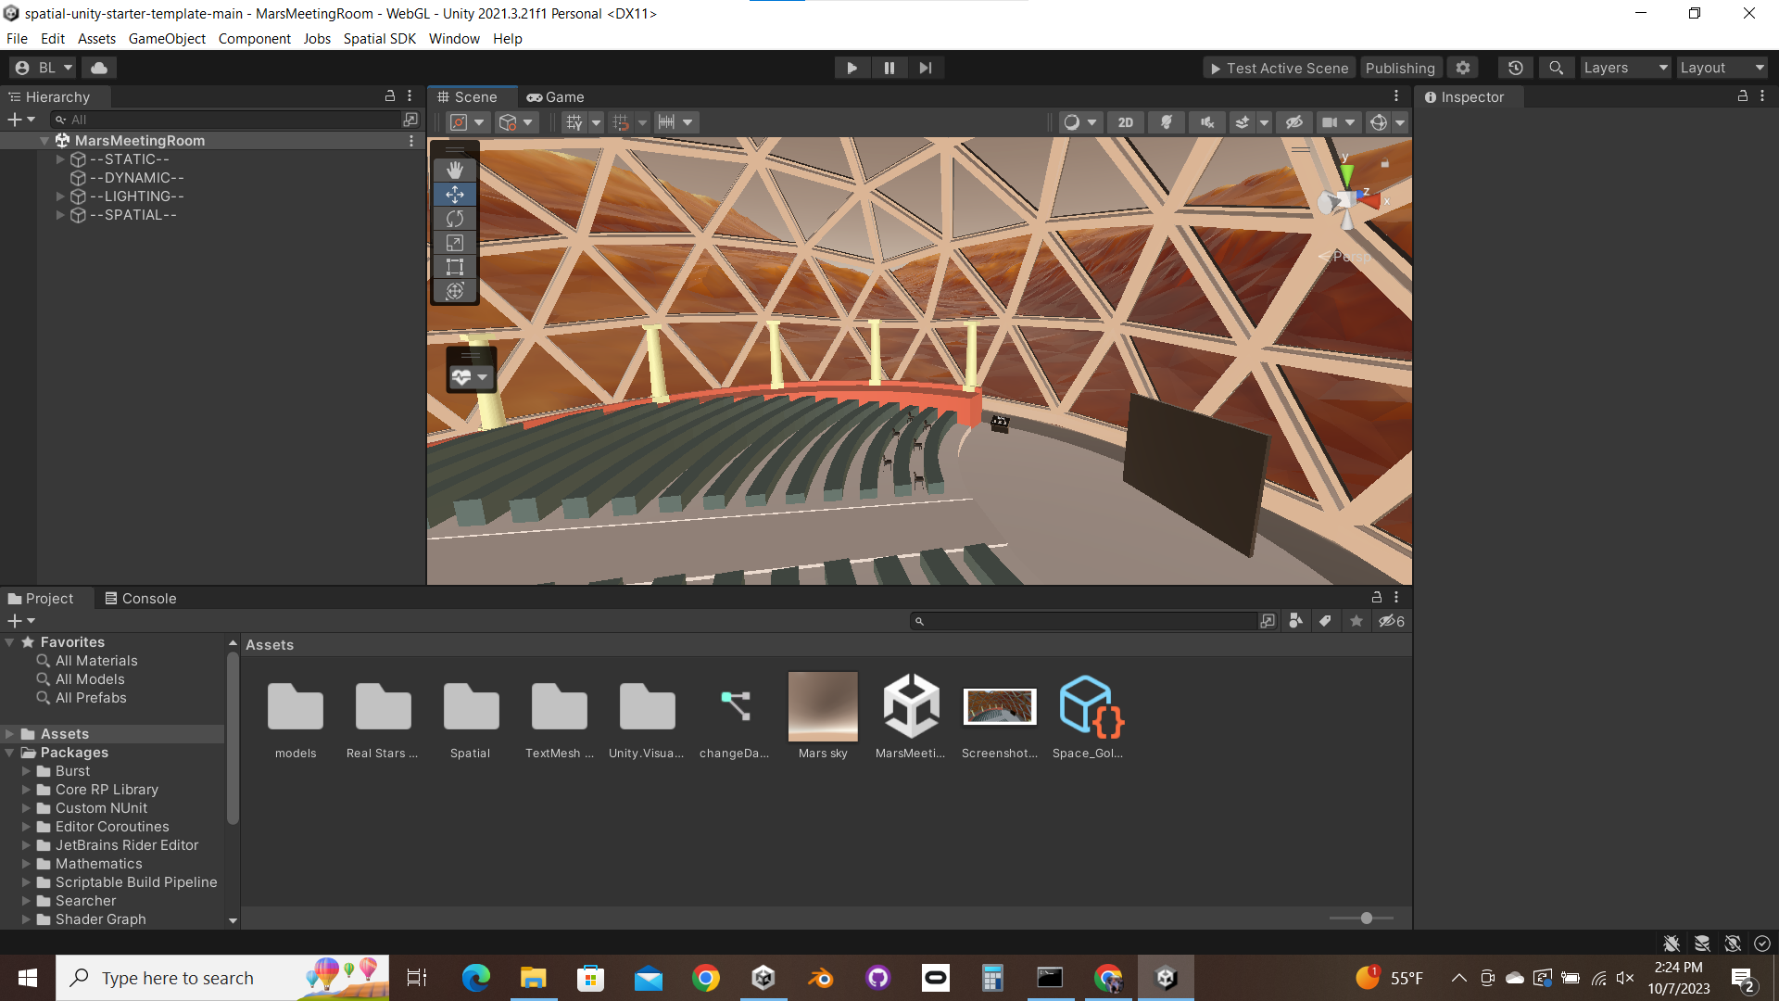
Basics What is Unity?
Unity (in Tandem with the Creator Toolkit) is used to create new scenes that will become Spaces for Spatial. Spatial recommends that you gain some Unity experience before using the Creator Toolkit.
Unity scenes are fleshed out by placing object files (.fbx, .blend, etc.) and creating scripts.
To be able to test your Space, make sure to use Unity Editor version 2021.3.21.
Additional Notes Below
Notes:
Unity is a real-time development platform which is free for most individual users. As one of the most well-known game development platforms in the US, Unity is most commonly used for regular 2-D and 3-D applications. However, Unity also offers the ability to make XR projects (meaning VR, AR, or anywhere in between). Unity VR projects, however, are very difficult to turn into something that can be used by many people at once. This is why Spatial is useful; It allows very quick and easy turnaround from developing a VR scene to being able to host the scene for many others to join.
Unity includes two applications, Unity Hub and Unity Editor. Unity Hub is simply an application that organizes your Unity projects and installs. It is the most convenient way to open your Unity projects. The Unity Editor is a real-time editor for Unity projects, in which you can add objects, scripts, settings, etc. to your projects, as well as build and publish them. Unity Editor 2021.3.21 is a long-term support (LTS) version upon which the Spatial SDK is built. As a result, 2021.3.21 must be used if you want to have all the functionality of the Spatial SDK, including testing and publishing (which you certainly do want).

Slide 5
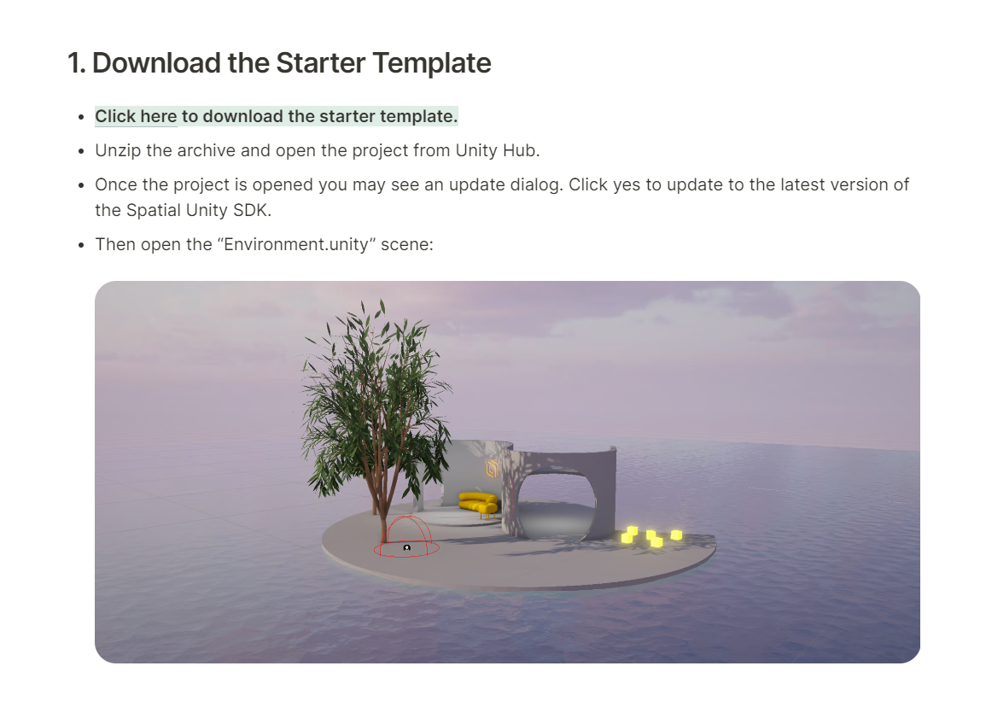
Creating a New Space Method 1 – Using the starter template
The Unity project that Spatial provides as a starter template can be found here. They recommend that you start from this template, as it is already set up with the Spatial SDK and several exemplary scenes/assets.
They outline this process in their documentation as well: https://docs.spatial.io/getting-started
Additional Notes Below
Notes:
The starter template is how Spatial recommends you begin your projects. This way the Spatial Unity SDK is already installed, and every setting is already configured for maximum functionality/performance. There is essentially no reason to avoid starting your Spatial projects with the starter template as it is far and away the fastest and easiest option.
While Spatial does have a documentation on their website, they skip over a lot of details. They also do not have documentation or any other information concerning some other aspects of their Creator Toolkit.

Slide 6
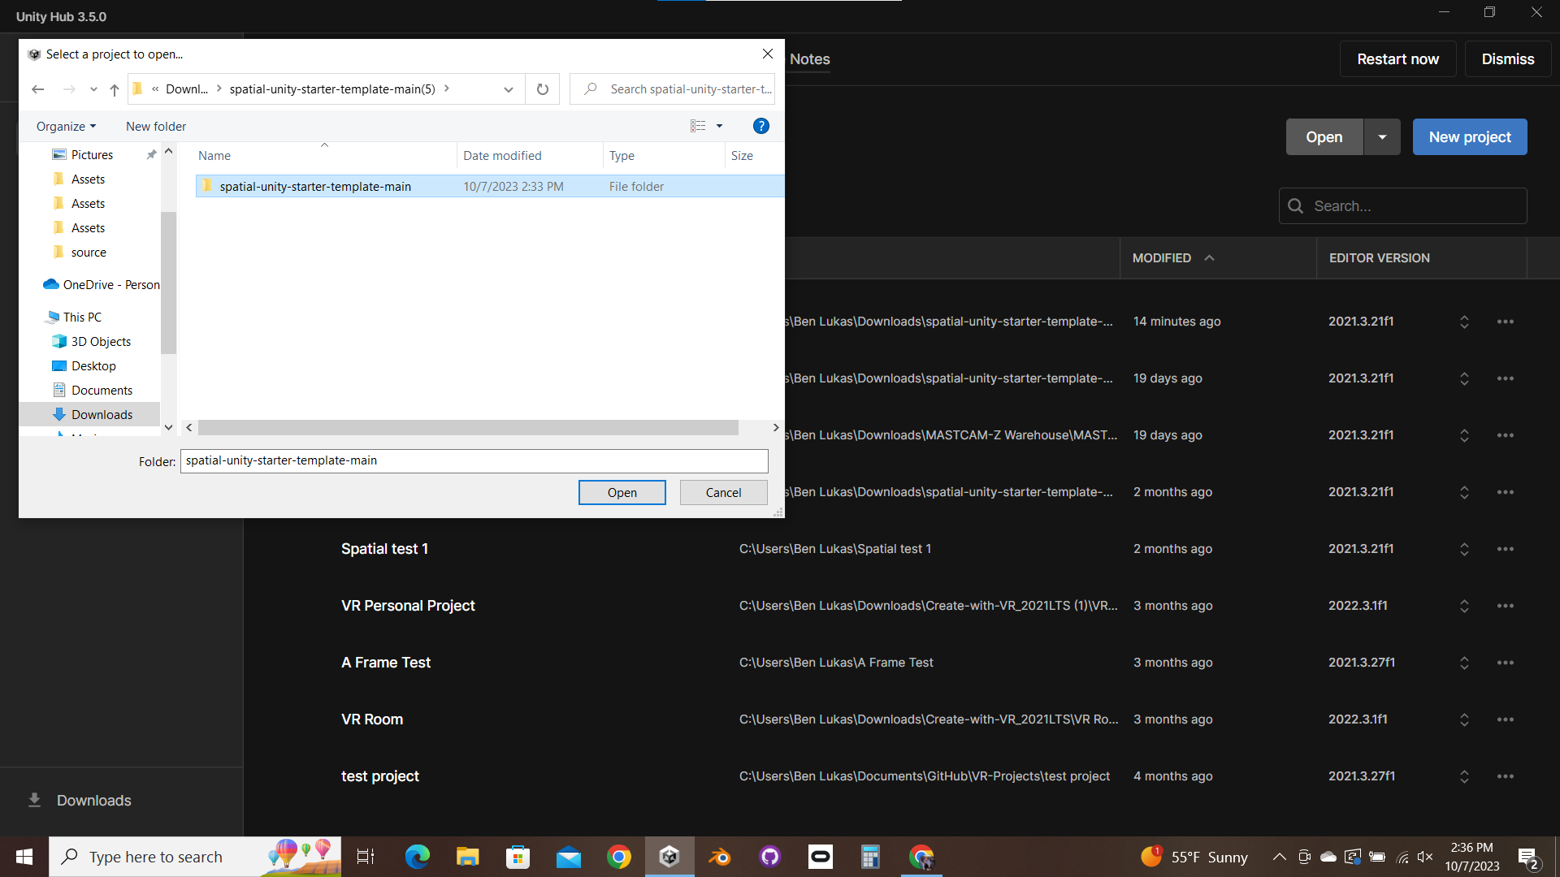
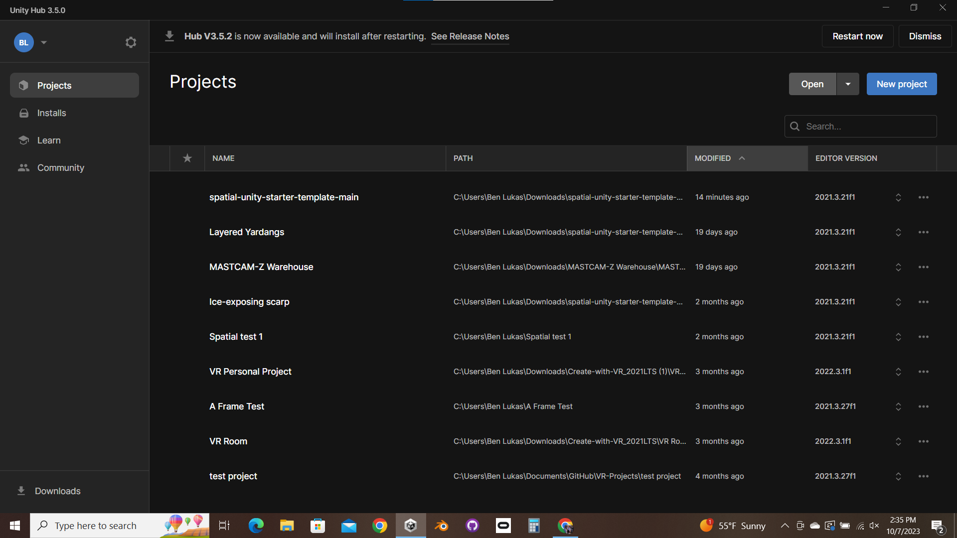
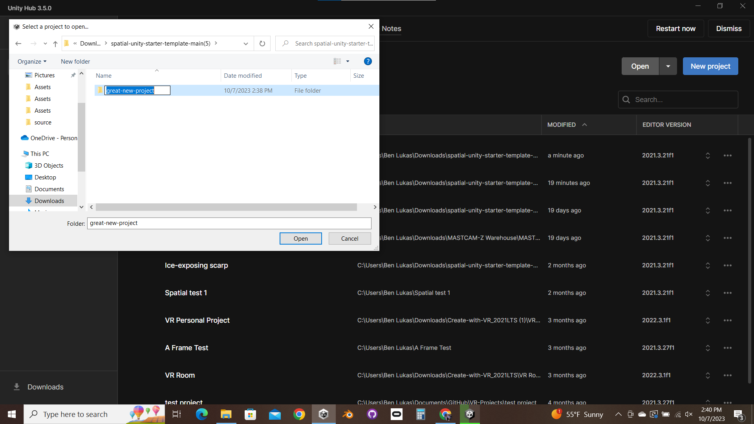
Creating a New Space Method 1 – Using the starter template
Once you have downloaded the template, simply open it from Unity Hub (this way the Hub will list it for easy access later). Again, make sure that Unity Editor 2021.3.21 is the version you are using to enable testing.
Find spatial-unity-starter-template-main>spatial-unity-starter-template-main, then click Open.
At this point you can rename it to whatever you want.

Slide 7
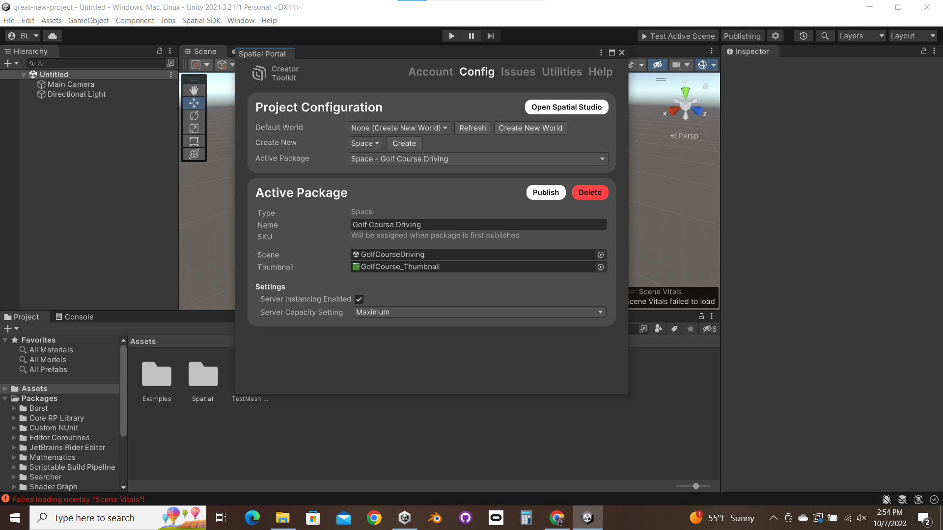
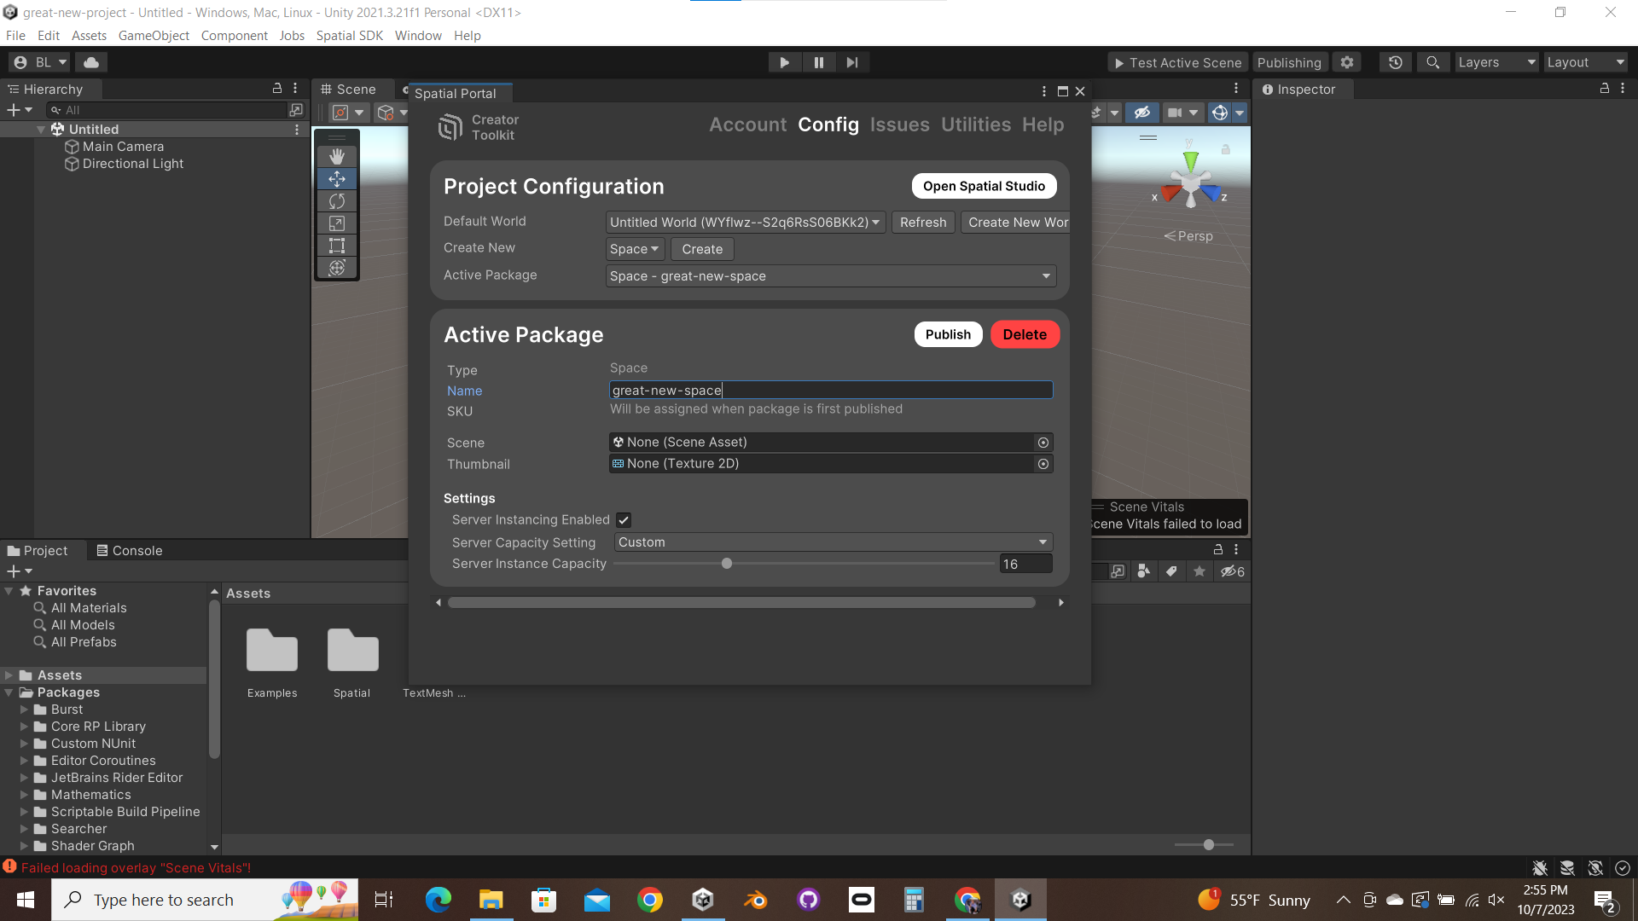
Creating a New Space Method 1 – Using the starter template
Click on Publishing to see your current Active Package. By default it is set to one of the assets from the starter template. Either create a new World or select an existing one. Then, create a new Space package and rename it to match your project. Select it as the new Active Package.
Additional Notes Below
Notes:
To Spatial, a "Package" simply refers to a Space, prefab, or avatar that you are uploading to their server. The packages associated with your Spatial account can be found at https://spatial.io/studio/packages.
A "World" is a group of Spaces and items. Within a World, the owner can create currency, badges, and items that are consistent throughout the different Spaces in that World. For most projects, assigning your new Space to any World will work just fine.

Slide 8
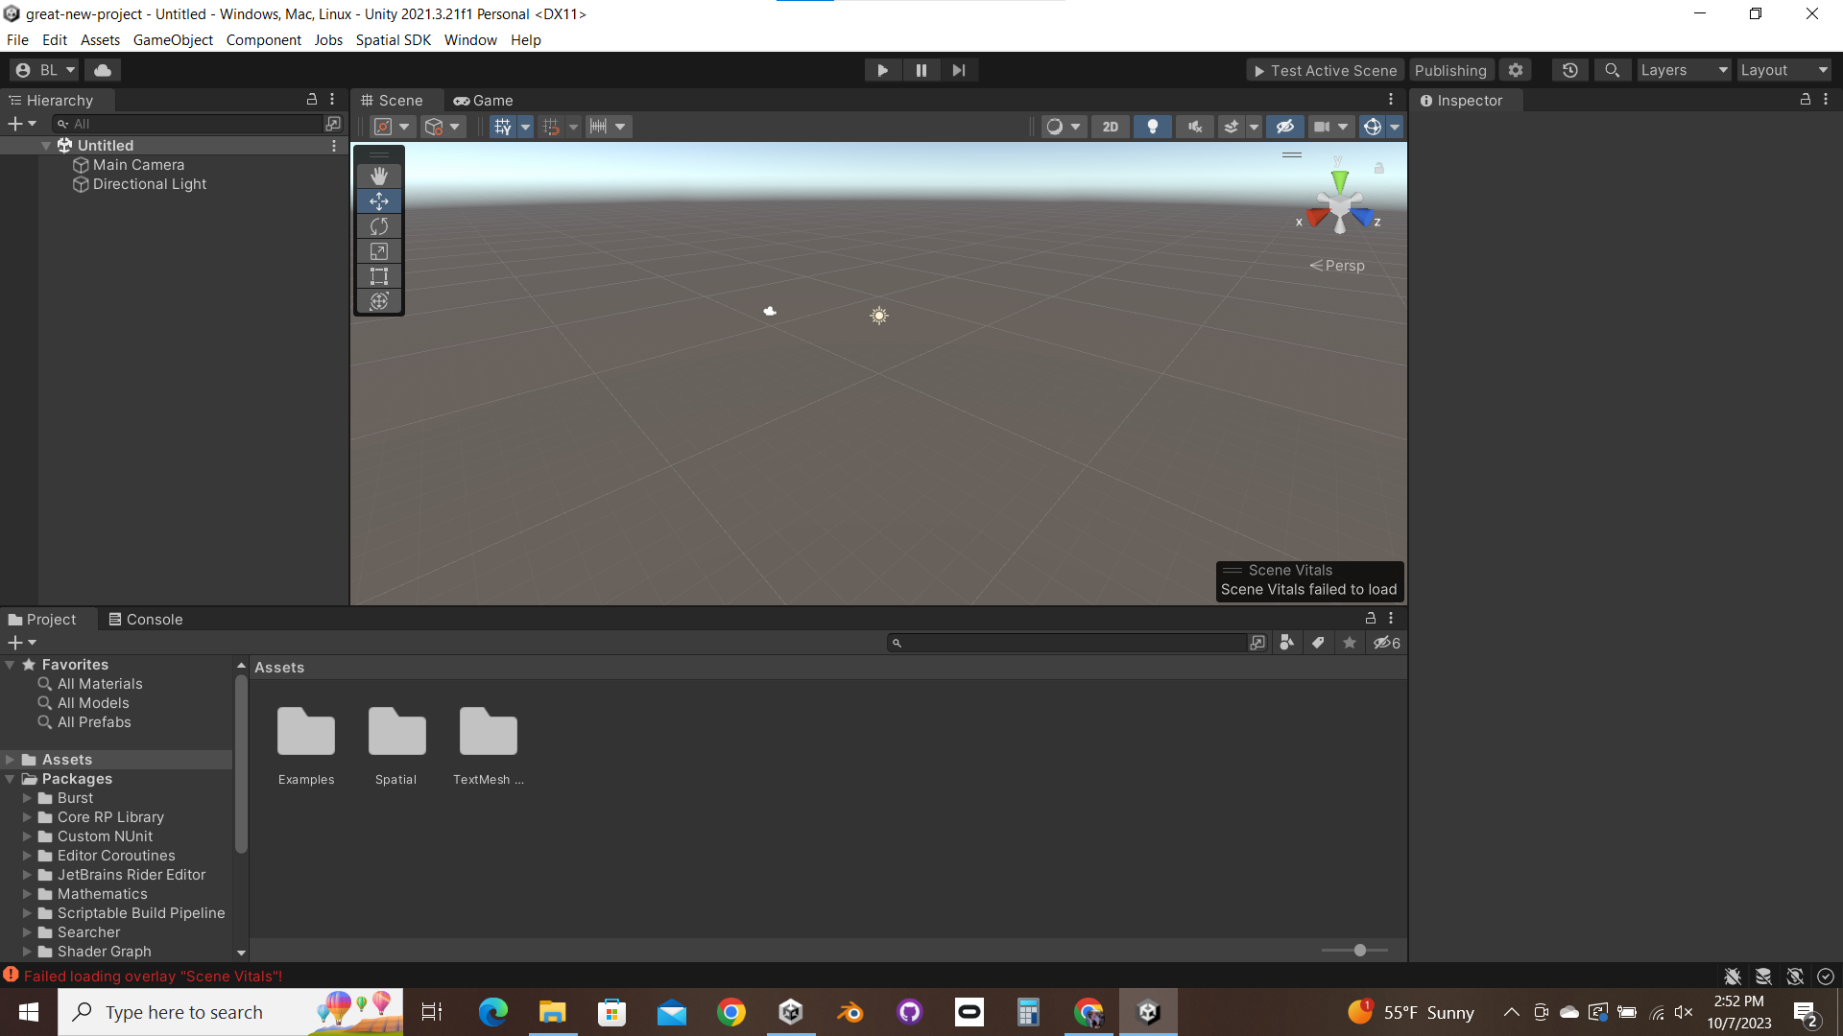
Creating a New Space Method 1 – Using the starter template
Upon opening the template in the Unity Editor, you will likely be asked to upgrade the Spatial SDK. Do this, and you will be in an empty scene, with several directories in your Assets.

Slide 9
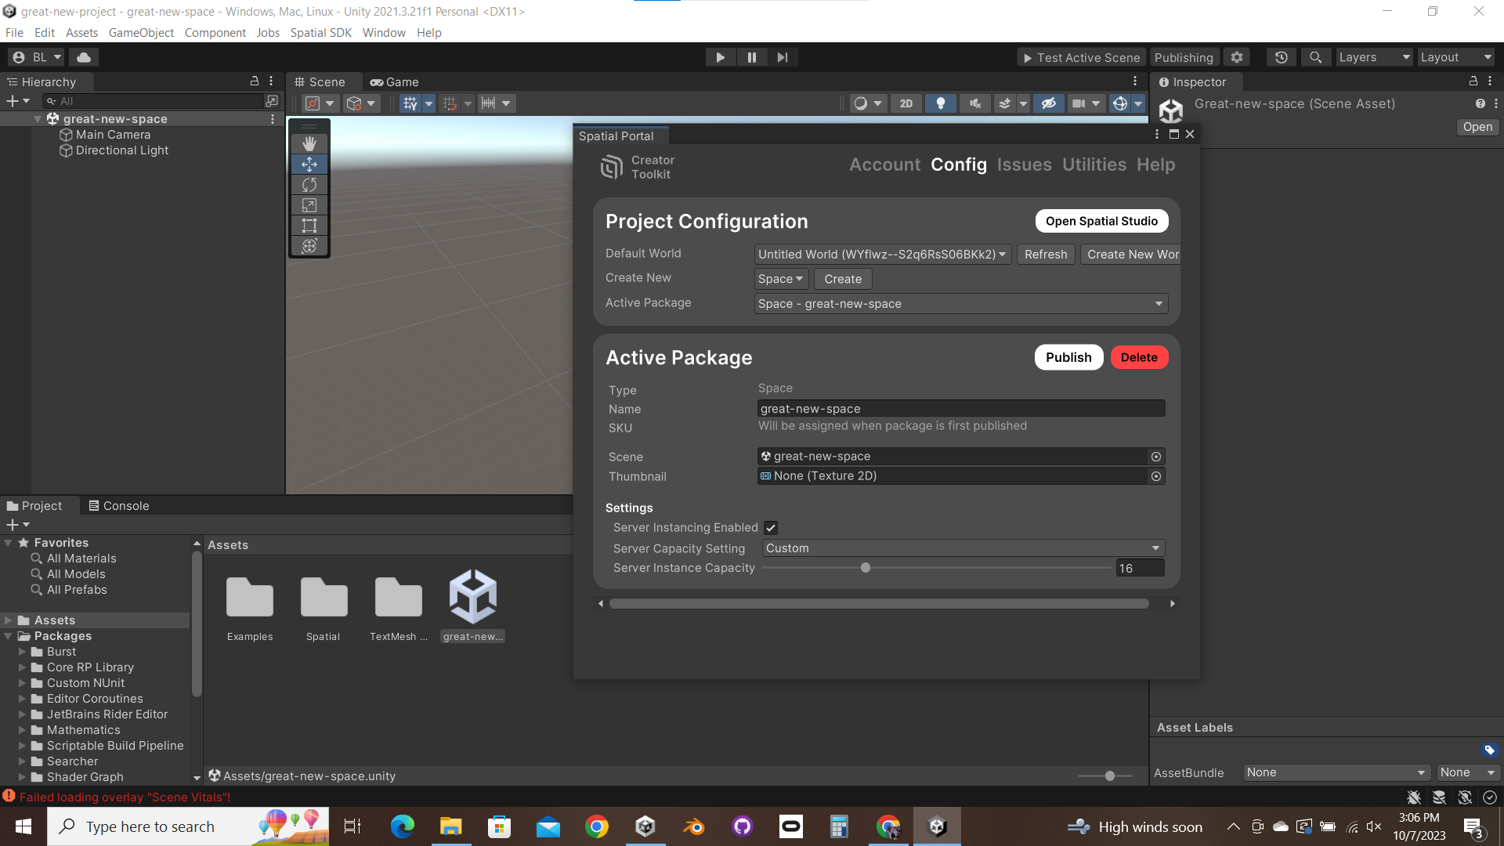
Creating a New Space Method 1 – Using the starter template
Create a new Scene asset for your Space and open it. Then, assign it to your Active Package.

Slide 10
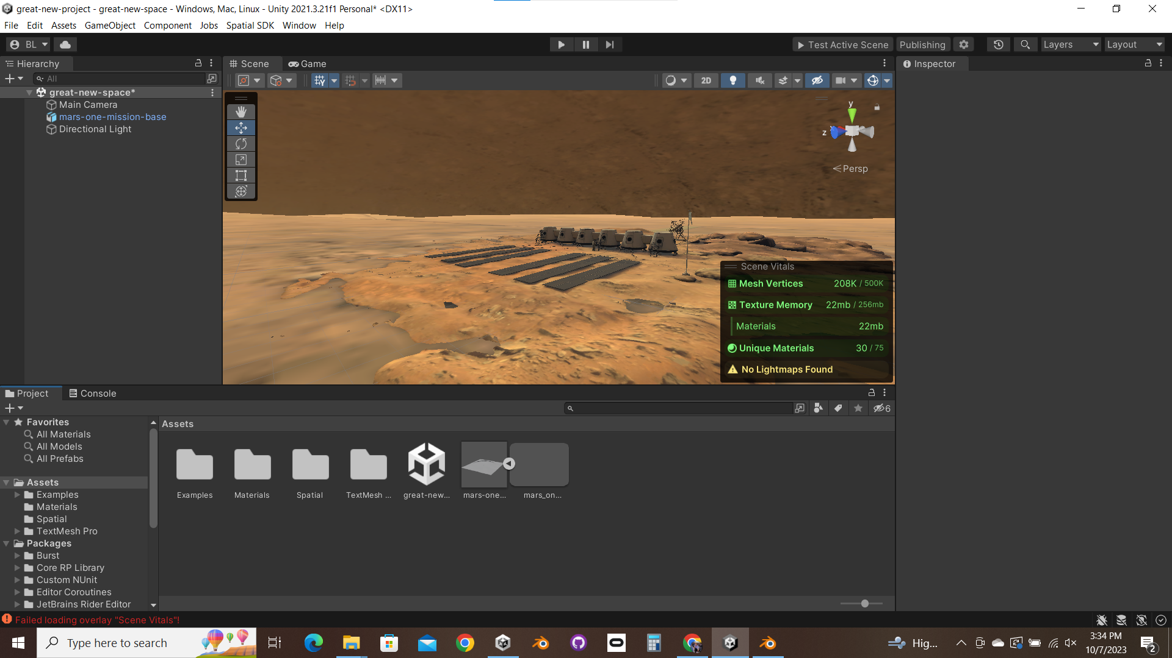
Creating a New Space Method 1 – Using the starter template
Now your empty Space is ready to be modified. Add an object to your room simply by dragging a .fbx or .blend file into your Assets directory, then dragging it from your Assets into the scene.
Additional Notes Below
Notes:
Find more information on importing objects into your Unity scene (especially for the purposes of Spatial):
---Here I will put a link to my documentation on just this^ whenever I get around to making it. :P----

Slide 11
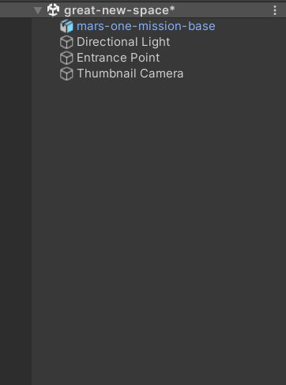
Creating a New Space Method 1 – Using the starter template
In order to test our Space, we will need to do a few more things.
Delete the "Main Camera" object in your scene.
Add an Entrance Point to your scene.
Add a thumbnail camera to your scene.
Make sure that your avatar has a collider to stand on. Add a collider to whatever object is supposed to be the floor and place the Entrance Point above this collider.
In order to trim down the size and upload time of our package, you can remove the "Examples" directory from your assets.
Additional Notes Below
Notes:
The Main Camera object that is in any new Unity project by default contains some components that are not supported by Spatial. Additionally, the Main Camera has no use for Spatial purposes.
2) To create an Entrance point: Right click on your Scene Hierarchy and select Spatial>Entrance Point. This is the spawn point that users will enter the scene at.
3) To create a Thumbnail Camera: Right click on your Scene Hierarchy and select Spatial>Thumbnail Camera. Once you publish your Space this thumbnail camera will capture live thumbnails for the Spatial homepage, portals, etc.
4) To add a collider to an object: Click on the object in the Object Hierarchy. In the Inspector on the right side of the screen, scroll all the way down to "Add Component". Type in "collider" and select the type that works best for your object. Mesh colliders can be used for objects that do not have a regular shape, but beware of using a mesh collider on an object whose model has very many vertices.

Slide 12
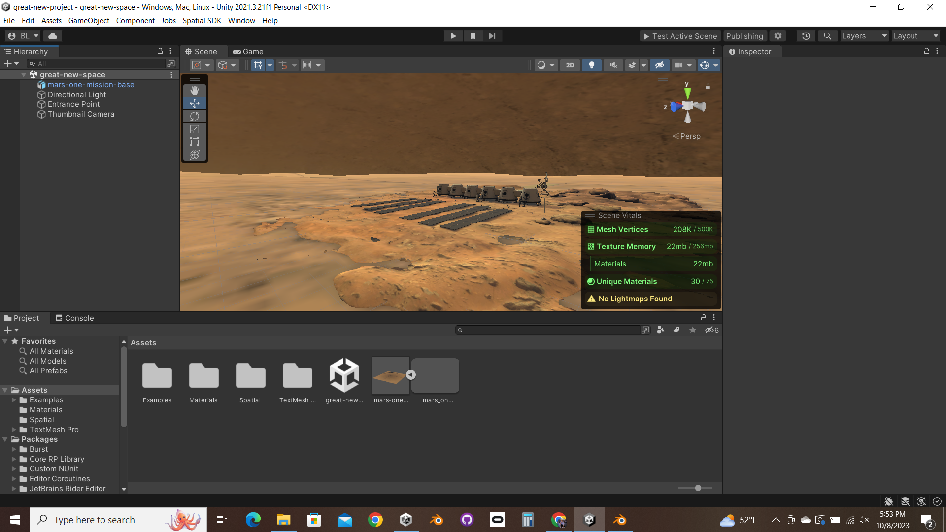
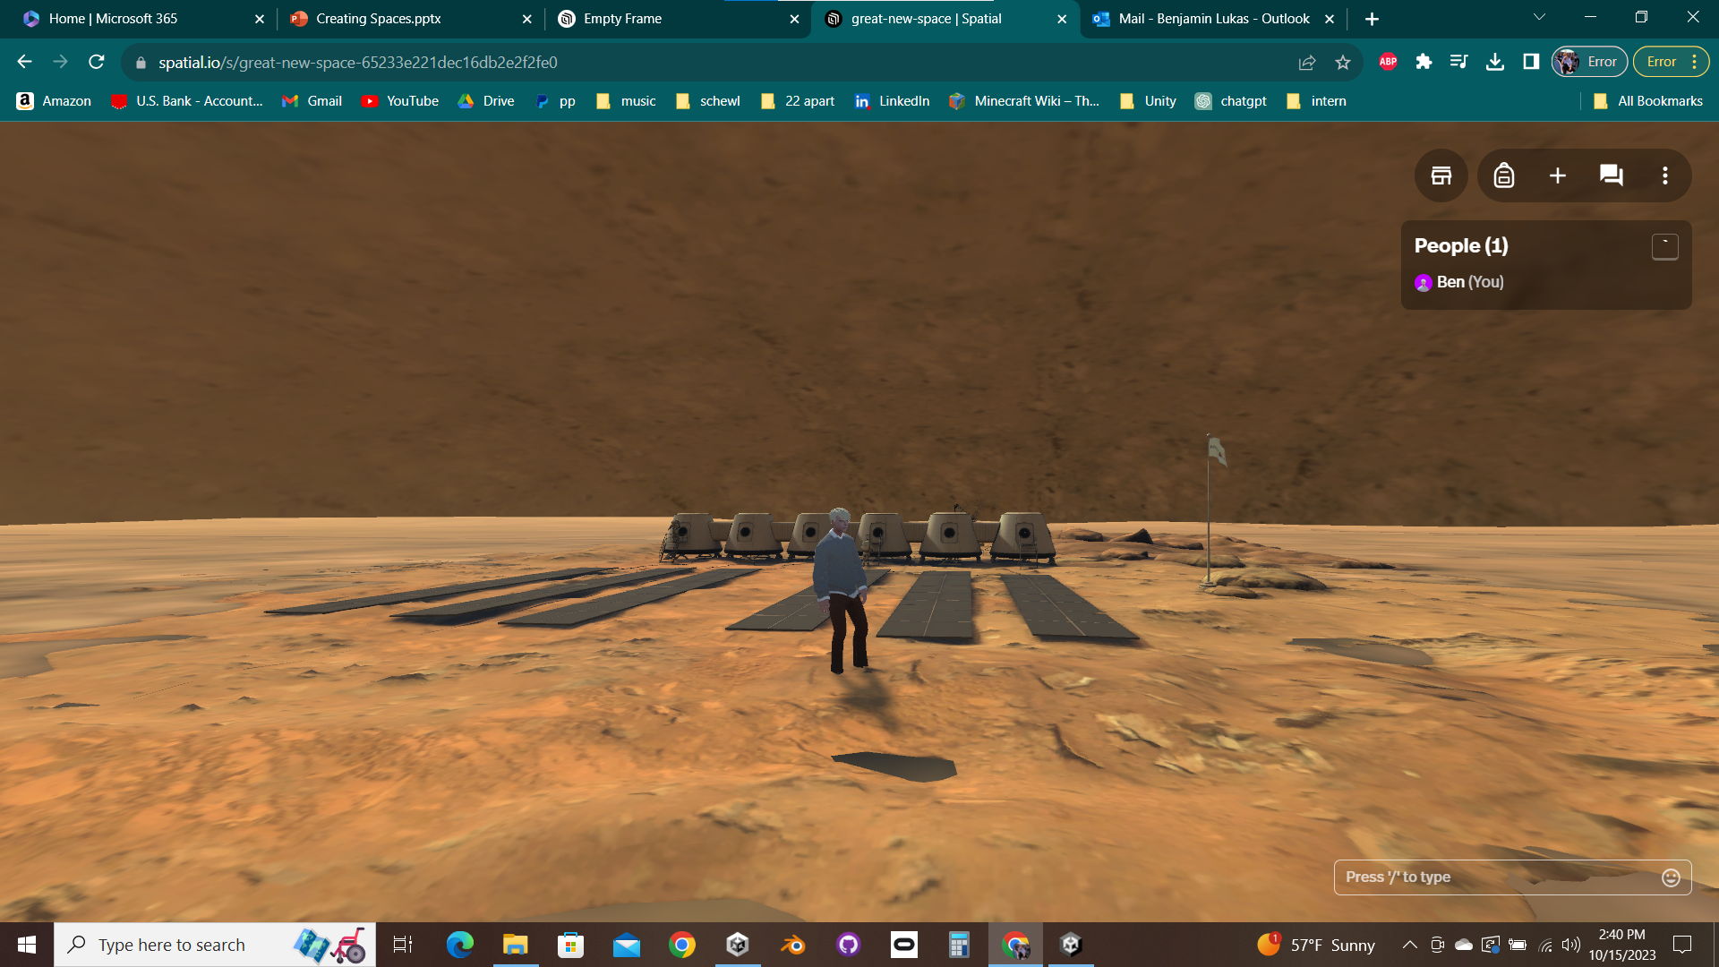
Creating a New Space Method 1 – Using the starter template
Now we can test our scene and see it in the browser version of Spatial. It's very quick and convenient for testing and bug-fixing your Space.
Click "Test Active Scene" (make sure you have selected the right Active Package).
If there are any other problems with your scene, it will let you know.
Additional Notes Below
Notes:
When you test an active scene, you are taken to a sandbox Space (https://spatial.io/sandbox). This is a private Space made from the active package the last time the user pressed "Test Active Scene". So, for example, your new scene that you are testing, or your new Prefab object that you are testing. Occasionally, Prefab objects can remain left over from previous active packages.
Upon clicking "Test Active Scene", if you are sent back to Spatial's homepage (spatial.io) it most likely means that Spatial is having problems with user's sandboxes on their end.
If there are issues with your scene, it will either create an urgent red warning that exits the scene testing routine, or it will create a non-urgent yellow warning and will still continue the scene testing routine. Red warnings come from issues such as not having an Entrance Point or a collider to stand on, and yellow warnings come from issues such as pushing the recommended limit of mesh vertices or unique materials.

Slide 13
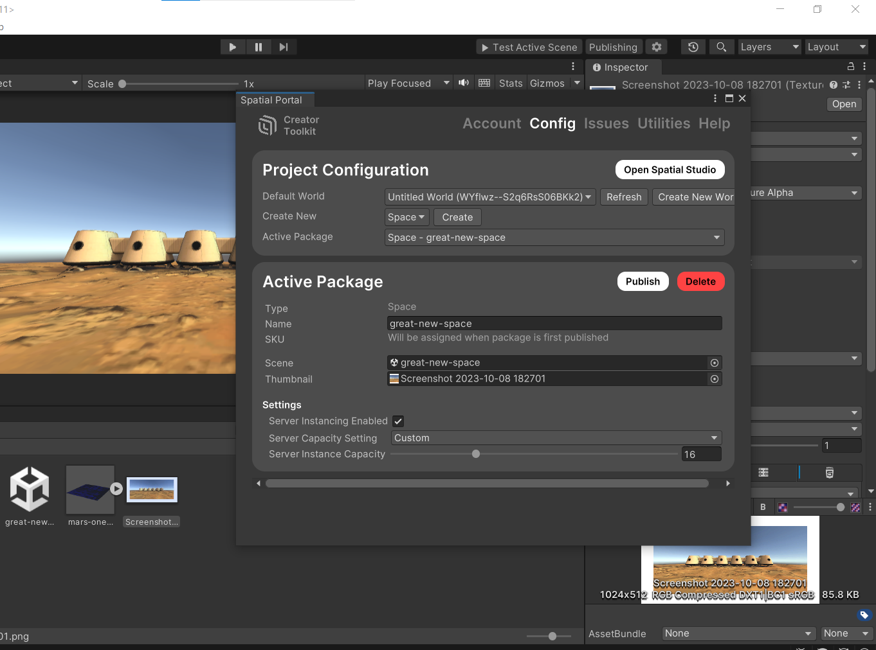
Creating a New Space Method 1 – Using the starter template
In order to get our package ready for publishing, we just need to add a thumbnail of our scene.
Take a 1024x512 screenshot (exactly) of your scene in Unity, and set it to the Thumbnail in your Active Package (use a photo editing app to crop your thumbnail to the right size).
In the future Spatial will automatically generate this thumbnail for you.
Additional Notes Below
Notes:
Publishing allows your scene to become a Space that is joinable from Spatial (on browser, or in the app store on mobile or Oculus Quest). Currently in the Spatial framework, publishing is the only way to see your custom scene in your VR headset.
Unfortunately at the moment the thumbnail for your active package must be created manually. Why it isn't created by the Thumbnail Camera object that we must add to every scene for Spatial is a mystery. However, they do claim in their documentation that this will be an upcoming feature.

Slide 14
Creating a New Space Method 1 – Using the starter template
Once you publish your Space, it will be available on both the Spatial website on desktop and the Spatial app in supported Virtual Reality headsets.
In your Active Package, simply click "Publish" and confirm that your Space coincides with Spatial's community guidelines.

Slide 15
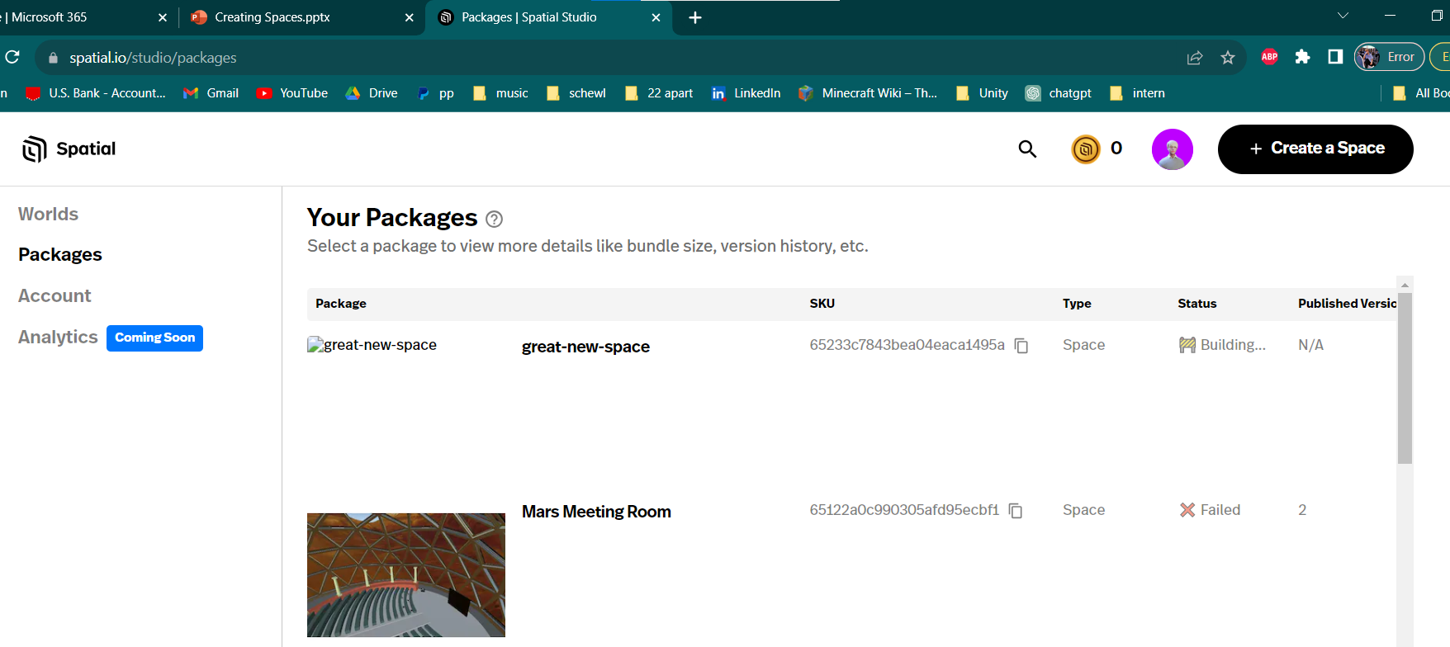
Creating a New Space Method 1 – Using the starter template
Your Space is now being uploaded to the Spatial servers. You can check on your package in Spatial Studio. Go to spatial.io/studio/packages, or click on "Open Spatial Studio" from your Active Package. Find the package in your packages list, and it should be marked as "Building" until it is eventually marked "Successful".
If your package ends up marked "Failed", try again later as it is often a problem on Spatial's end.

Slide 16
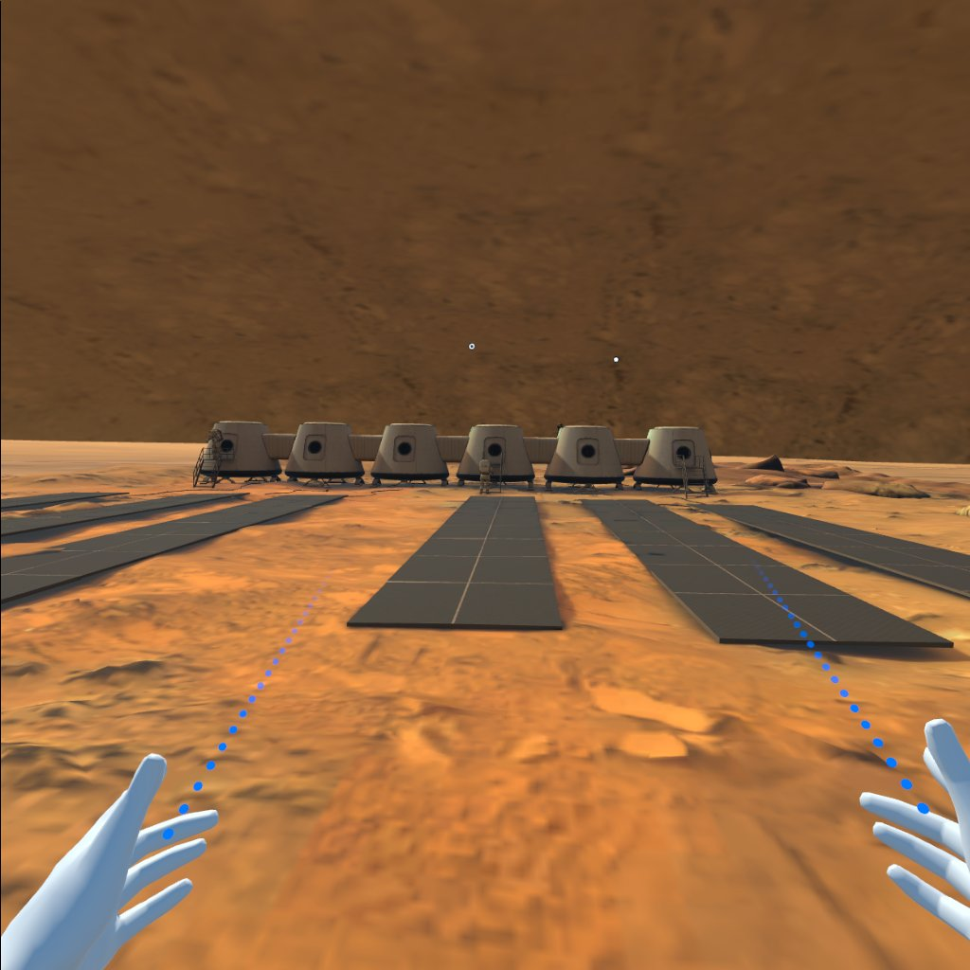
Creating a New Space Method 1 – Using the starter template
Once your package successfully uploads you can find it in the Spatial App under My Spaces (assuming you are logged into the same account that you published it from). Now your Space can be experienced in VR, and it can be shared and joined by others.
Notes:
In order to share your Space, you must either share a link to someone or make the Space publicly listed. To do this, join your Space on either browser or Oculus. For browser, click the top-right menu (the vertical …) and select Share Space (box with an arrow). Then, you can turn "Publicly listed" on and copy your Space's link. For Oculus, open your UI menu (the dots at the bottom of your view that follow you everywhere). Click the "Invite" button (a person with a plus) and a menu for inviting people by email will pop up.

Slide 17
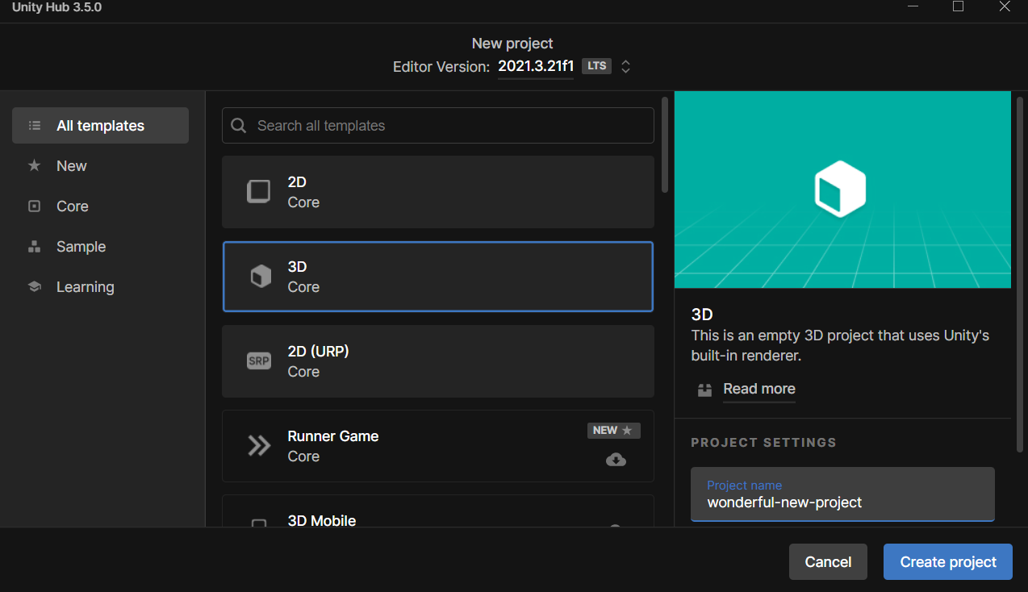
Creating a New Space Method 2 – Manual Configuration
There is another way to create a project in Unity and turn it into a Space. Instead of using Spatial's starter template project, we can start from an empty Unity 3D project.
Before we begin, it is worth noting that this method of creating a new Spatial project is not recommended. It involves a lot of importing packages and changing settings.
Additional Notes Below
Notes:
This method is not only not recommended but also quite cumbersome. Furthermore, there will be many settings that are not quite the same between the end result achieved from the first method (using the starter template) and this method.
Use the starter template.

Slide 18
Creating a New Space Method 2 – Manual Configuration
To begin from scratch, from Unity Hub, create a new 3D project (make sure that Editor version 2021.3.21 is selected) and name it anything that you want.

Slide 19
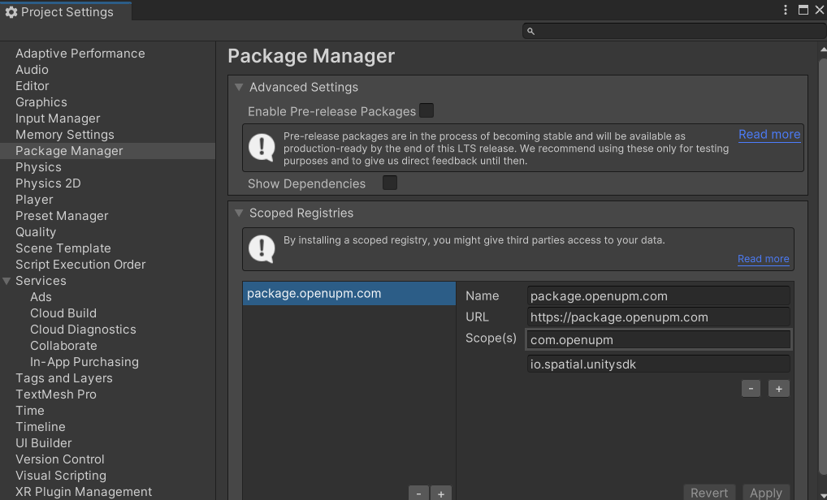
Creating a New Space Method 2 – Manual Configuration
Once your project loads into Unity Editor, in the top menu select Edit>Project Settings. Find the Package Manager tab. Under "Scoped Registries", add this and click "Apply":
Name package.openupm.com
URL https://package.openupm.com
Scopes com.openupm
io.spatial.unitysdk
Additional Notes Below
Notes:
Adding a scoped registry allows you to add packages from the Internet to your Unity project. This will be useful so that we can add the Spatial Unity SDK package. Packages that are found within your scoped registries are located in the Package Manager under "My Registries" for installation.

Slide 20
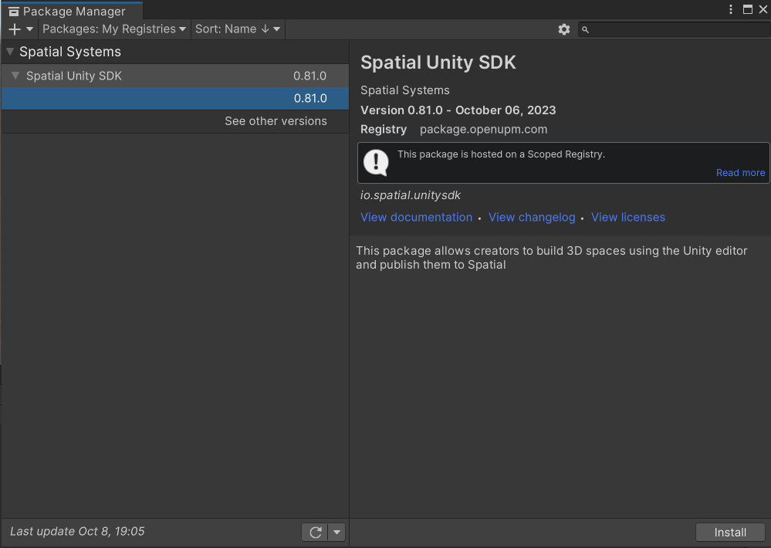
Creating a New Space Method 2 – Manual Configuration
Now we can install the Spatial Unity SDK as a package.
In the top menu, go to Window>Package Manager. In the Packages dropdown, select "My Registries", and you should see "Spatial Unity SDK". Click on it and click "Install".

Slide 21
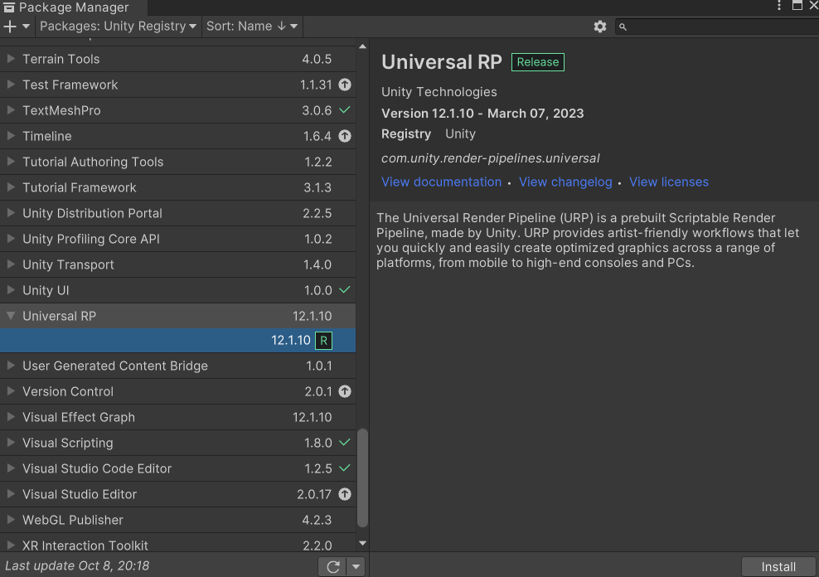
Creating a New Space Method 2 – Manual Configuration
We will need one more package to use the Spatial SDK. In the Packages dropdown, select Unity Registry. Look for "Universal RP" and install it.
Additional Notes Below
Notes:
The Unity Registry includes all kinds of packages that Unity recognizes as commonly helpful and relevant, but are not included by default in every Unity project. It is quite analogous to adding packages to a project in C, Java, Python, etc. using an import statement.
The Universal Render Pipeline is a graphics pipeline that is utilized by the Spatial SDK. It is necessary to install this package as well because otherwise you will not be able to render graphics in Spatial—your whole scene will still be interactable, but invisible.

Slide 22
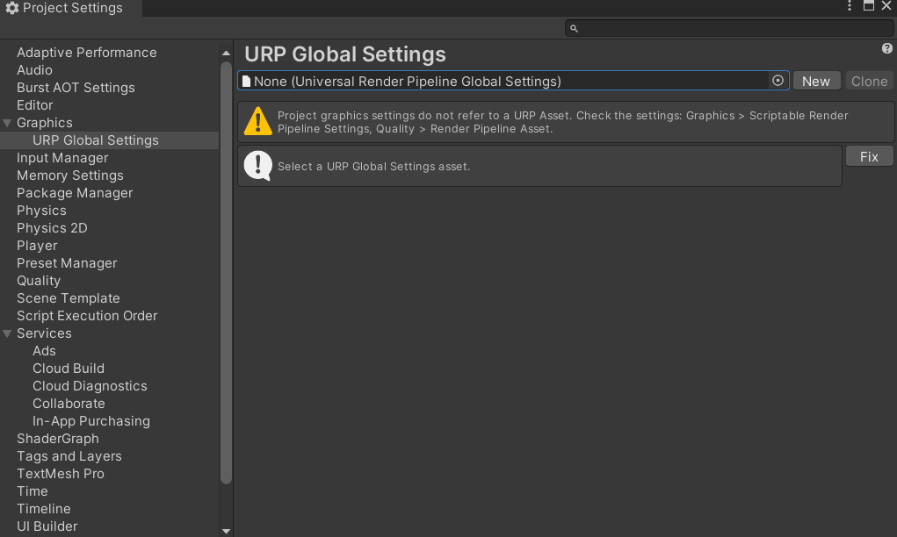
Creating a New Space Method 2 – Manual Configuration
Now we have to configure our project to use the URP. Click on Edit>Project Settings. Find the tab for Graphics, under which should be another tab called URP Global Settings. A warning will be there; Simply hit "Fix" to apply the Spatial URP global settings.

Slide 23
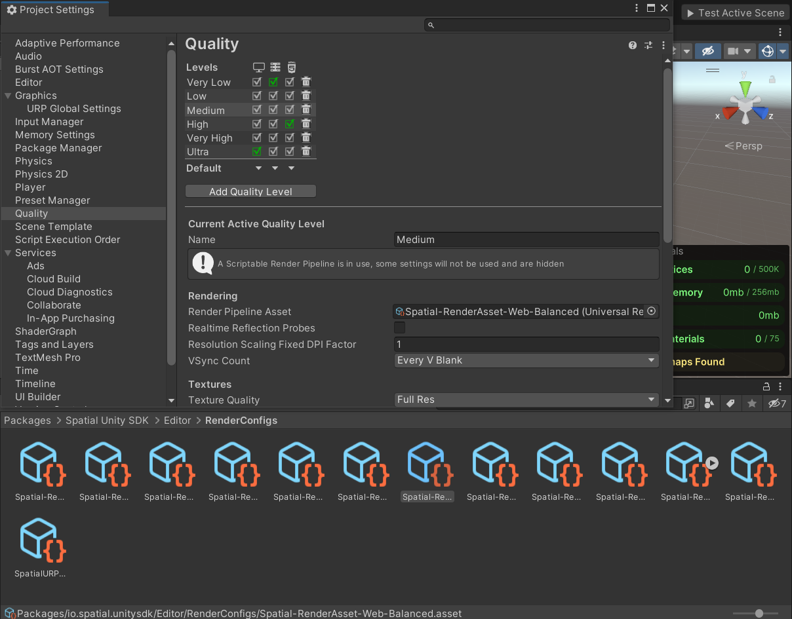
Creating a New Space Method 2 – Manual Configuration
We still need to update the graphic settings. In the same Project Settings window, find the tab for Quality. At the top, select Medium. Then, under "Rendering", we must change the Render Pipeline Asset. In your project's directory, find Packages>Spatial Unity SDK>Editor>RenderConfigs. Select the one that is "Web-balanced".
Additional Notes Below
Notes:
You are able to use different Quality settings and RenderConfigs if you would like. Medium and Web-balanced is what is used in the starter template, and since Spatial seems to have a bias towards browser this makes sense. For instance, if you wanted your scene to run really well on an Oculus and you didn’t care much about other platforms, you could select the Quest-Performant RenderConfig. If you wanted your scene to render with very high fidelity on browser with little concern for performance, then you could select Ultra quality and the Web-HighFidelity RenderConfig.

Slide 24
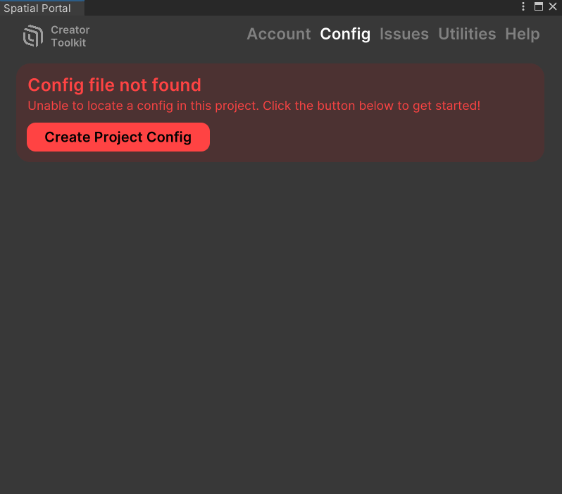
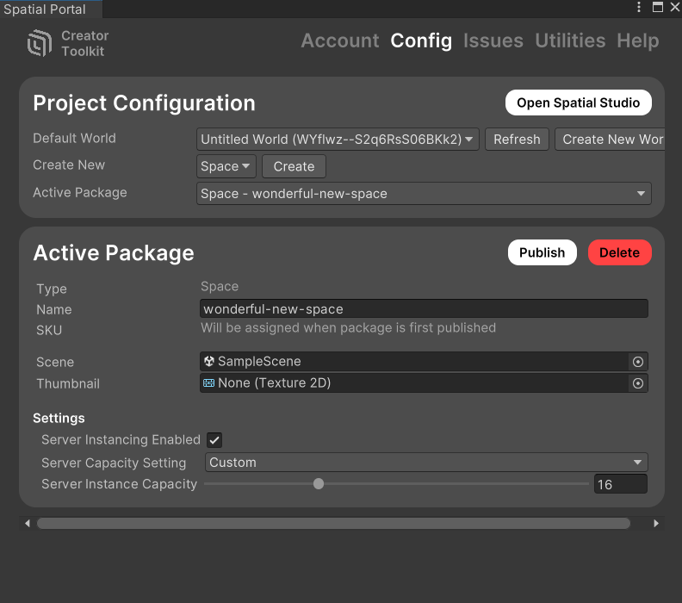
Creating a New Space Method 2 – Manual Configuration
We must now create a Project Config so that Spatial knows what package we are using. Go to Publishing and click "Create Project Config", then fill it out appropriately.

Slide 25
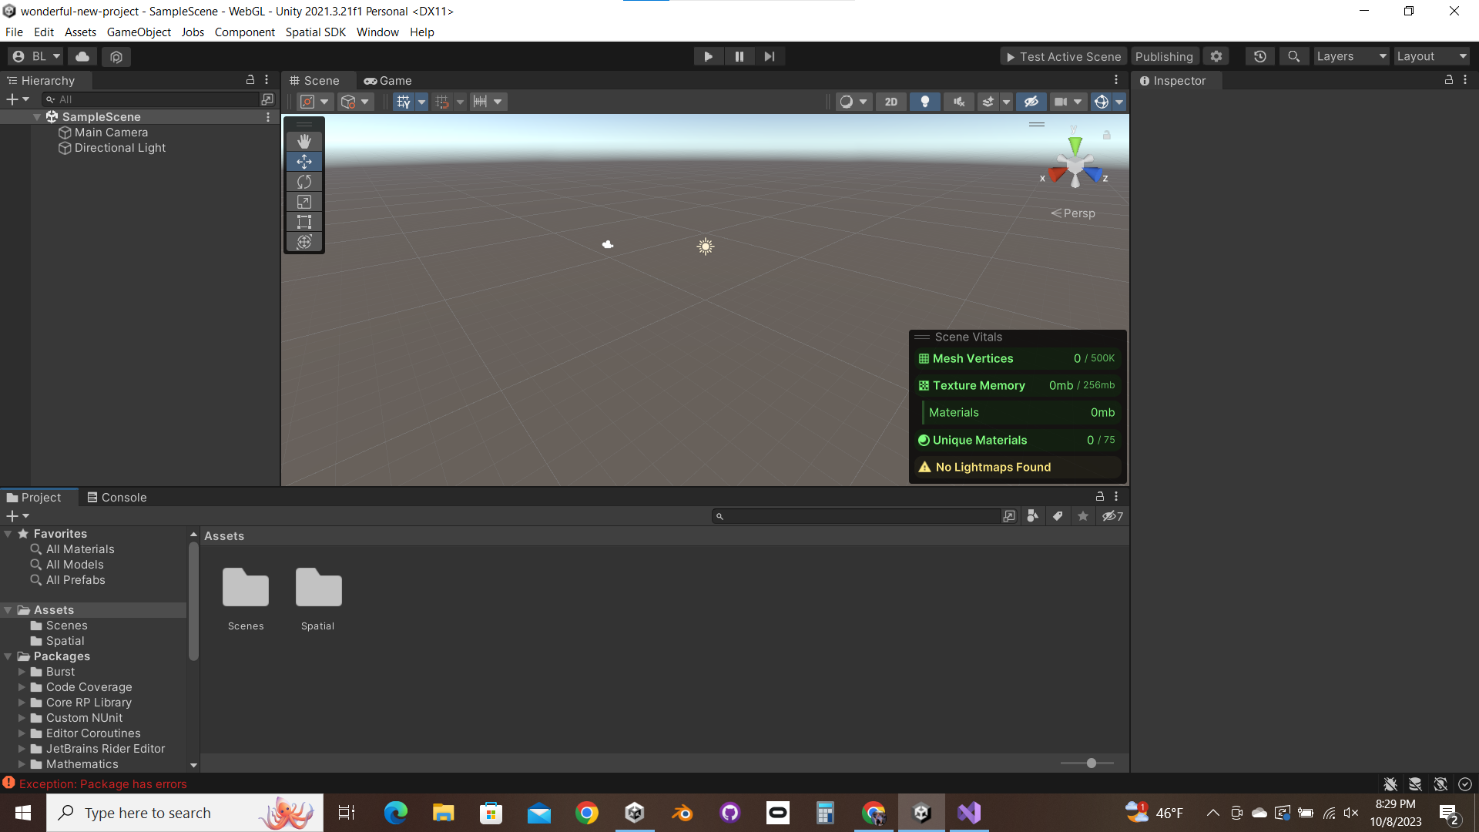
Creating a New Space Method 2 – Manual Configuration
Now that your project is configured for publishing to Spatial, you can carry on just as you did with the other method, starting from Slide 9.
This means adding the necessary Spatial assets and adding some objects to your room.

